Slide 1
Group Regression Project
MGIS 650
Group Members-
Jhalak Sadana, Priyanka Prattikantham and Matt Higgs

Slide 2
Regions of the country that are prone to cancer

Slide 3
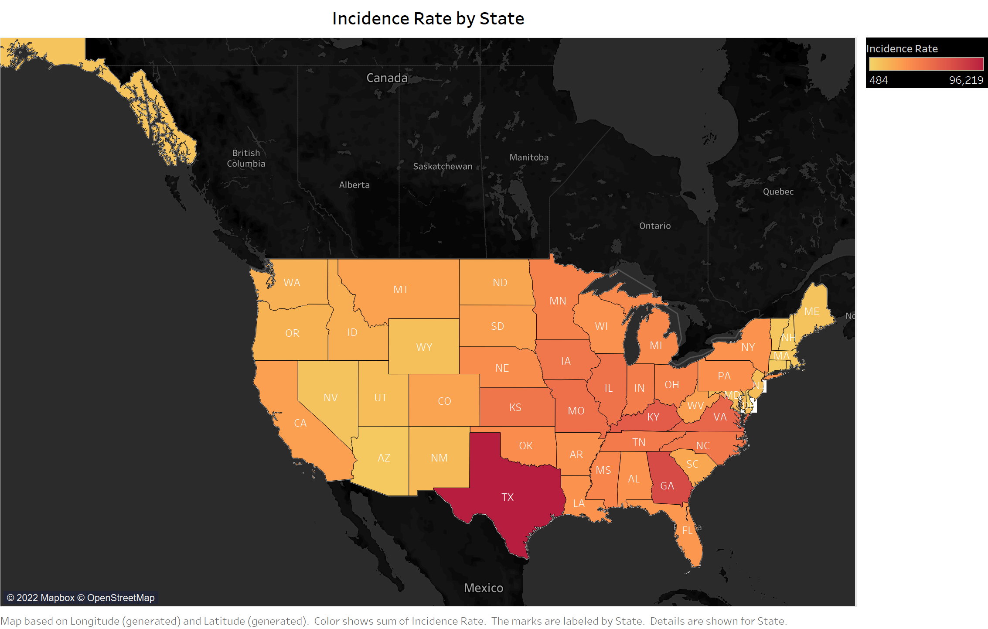

Slide 4
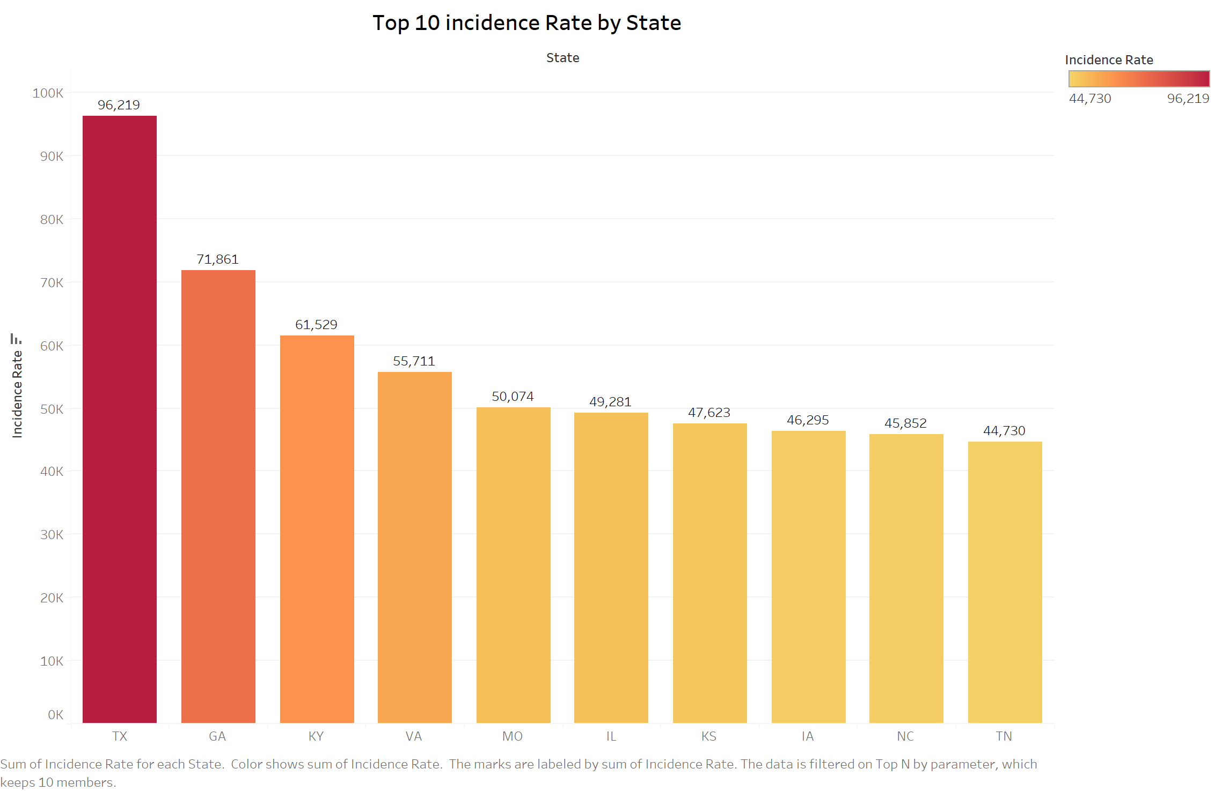

Slide 5
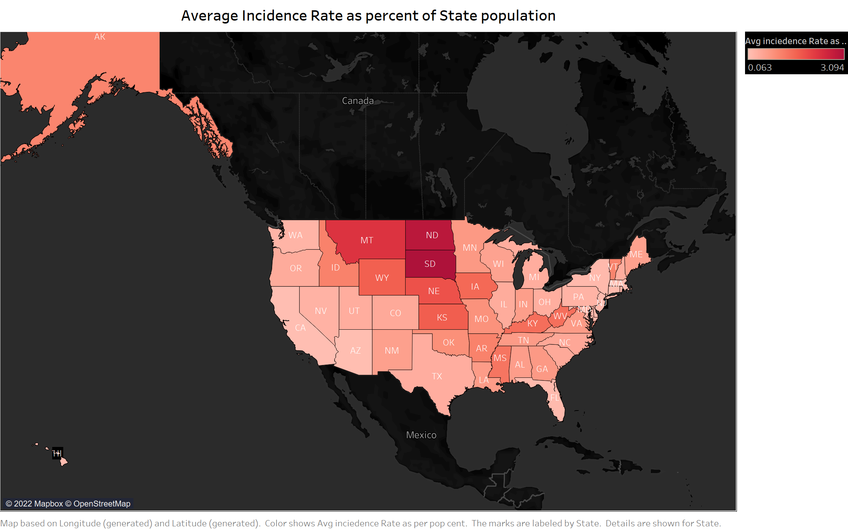

Slide 6
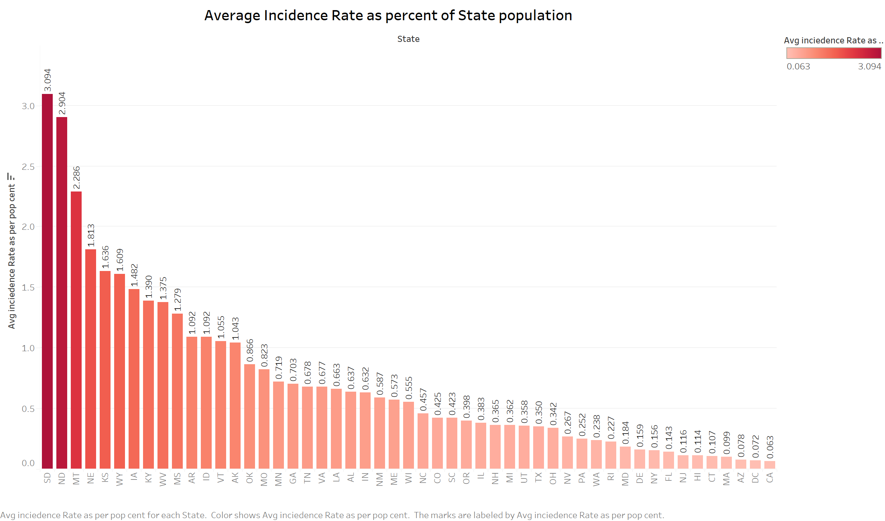

Slide 7
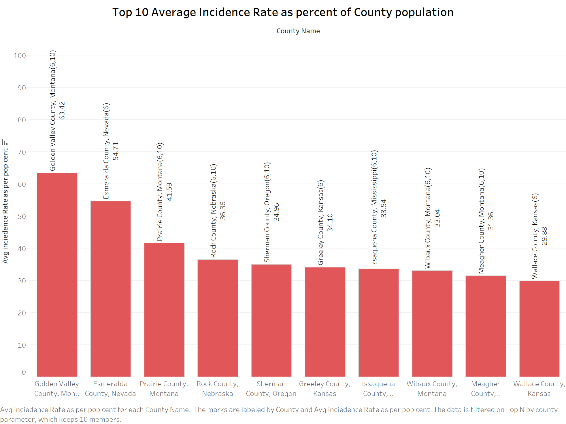

Slide 8
4 level indicator for median income & comparative analysis of the incidence rate with median income

Slide 9
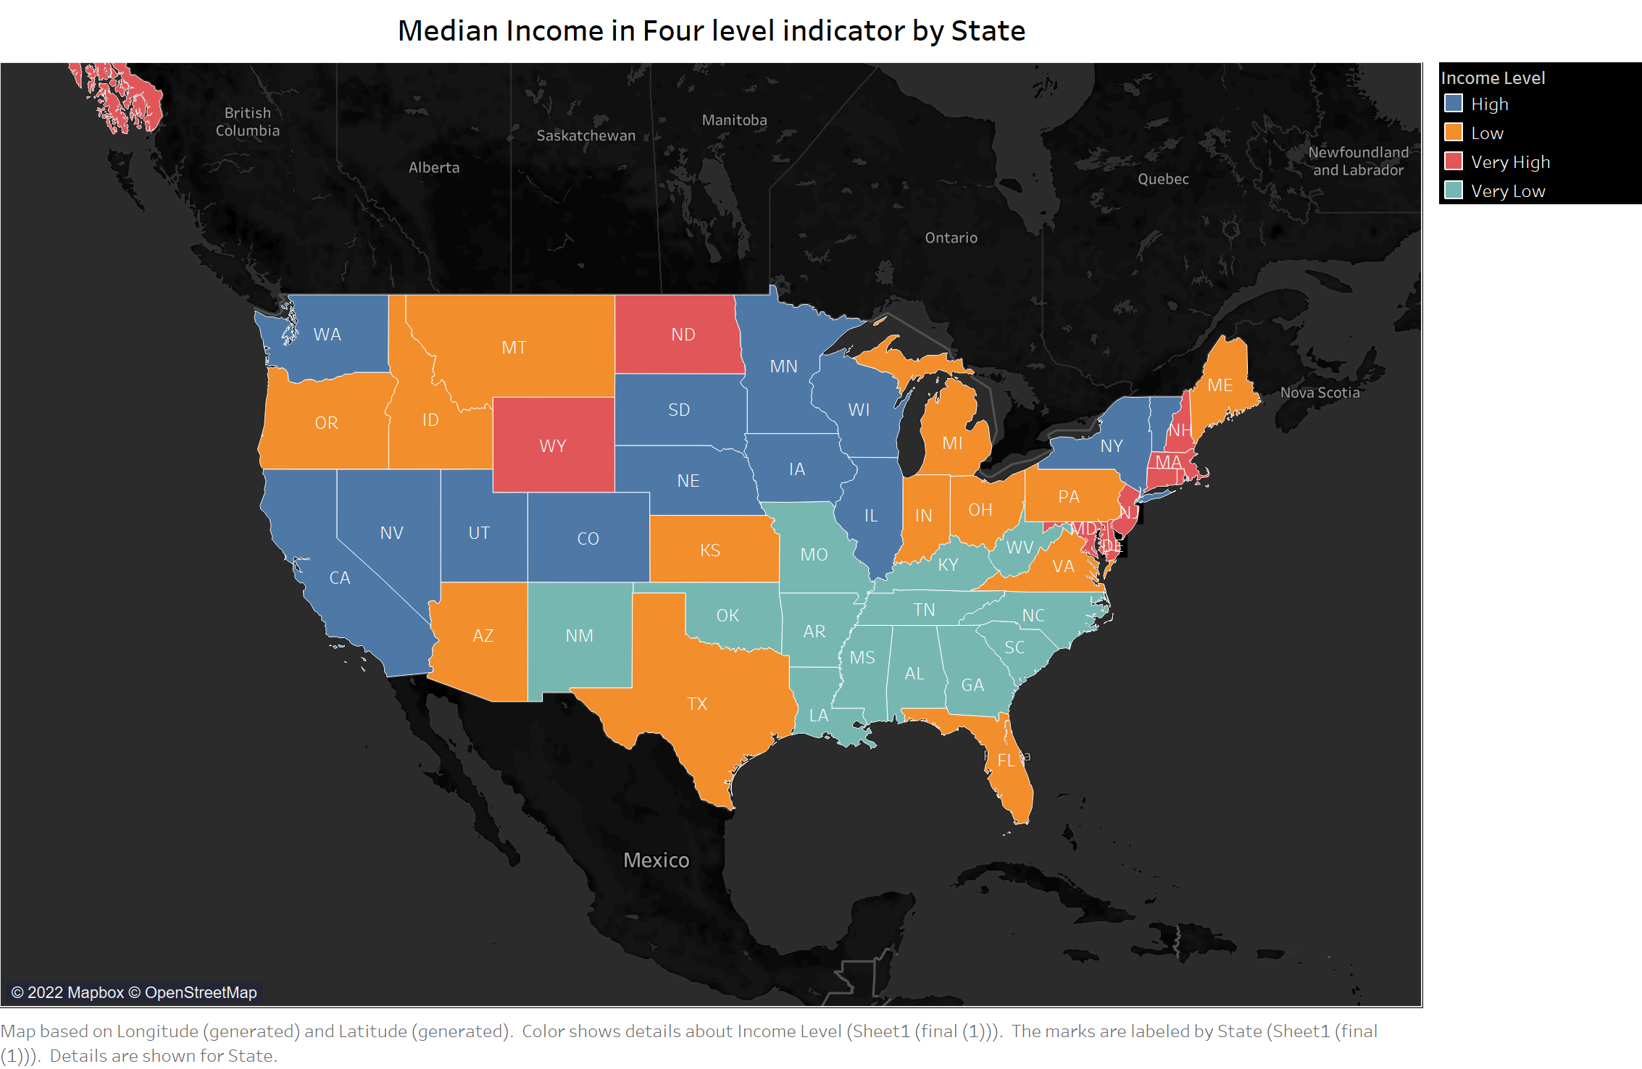

Slide 10
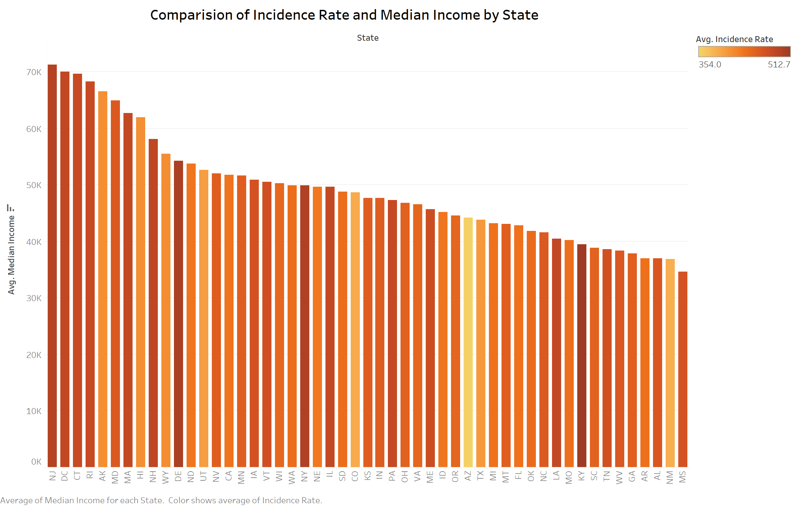

Slide 11
Correlation Analysis
Correlation analysis is a statistical method used to determine if there is a relationship between two variables. We used scatter plots to visualize the results of a set of data in order to gain a generalized but more immediate interpretation.
Based on our findings, we decided to conduct a correlation analysis between the incidence rate and four other variables: poverty estimates, Med income, population estimates, and death rates.

Slide 13
Incidence rate vs Poverty Est
The correlation between the incidence rate and the poverty rate is 0.013413481. It appears that there is no relationship, or correlation, between the two variables. Correlation coefficients range from -1 to 1. A "0" indicates that there is no relationship between the variables. Variables have a stronger relationship when they are close to one or a negative number.

Slide 14
Incidence Rate vs Med Income
The Graph of the scatter plot indicates that the data points do not have any relationship since they are spread out vertically. Incidence rate and Med Income have a calculated correlation of -0.002948919, which indicates no significant relationship exists.

Slide 15
Incidence rate vs PopulationEst2015
Data points appear in a scatter plot without any discernible trend which indicates no linear relationship. 0.023980934 was found to be the correlation between the incidence rate and the population. As a result of this, along with the scatter plot, it appears there is no statistical relationship between incidence rate and population.

Slide 16
Incidence rate vs Death rate
The scatter plot graph shows the spread of data points, however, in a vertical formation which indicates there is no relationship between the variables. The correlation between the incidence rate and the death rate is 0.447938904 which proves there is not a strong relationship between them. Using all four factors selected, it can be seen that there is no relationship between the incidence rate and any of the factors selected. In a correlation chart, the population estimate in 2015 and the poverty estimate had the highest positive correlation (0.968736422).

Slide 17
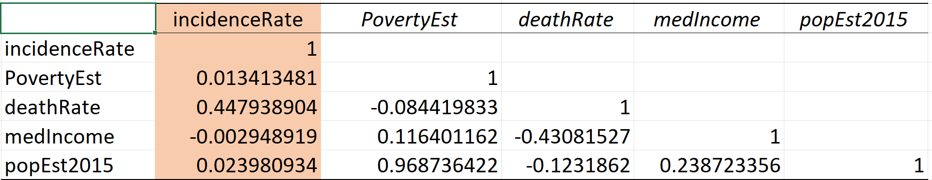
An analysis of the correlation between the Incident rate and four other factors: Poverty estimated, Median Income, PopEst2015, and Death rate

Slide 18
Regression
In statistical analysis, multiple linear regression is based on the values of two or more variables to predict an outcome for a variable. We refer to the variable we want to predict as the dependent variable, while the independent or explanatory variables we use to predict the value of the dependent variable are known as the explanatory variables.
An incidence rate regression analysis demonstrates the relationship between the target variable and the input variables. Among the input variables used in the analysis are Poverty Estimates, Population Estimates, Median Income, and Death Rates.

Slide 19
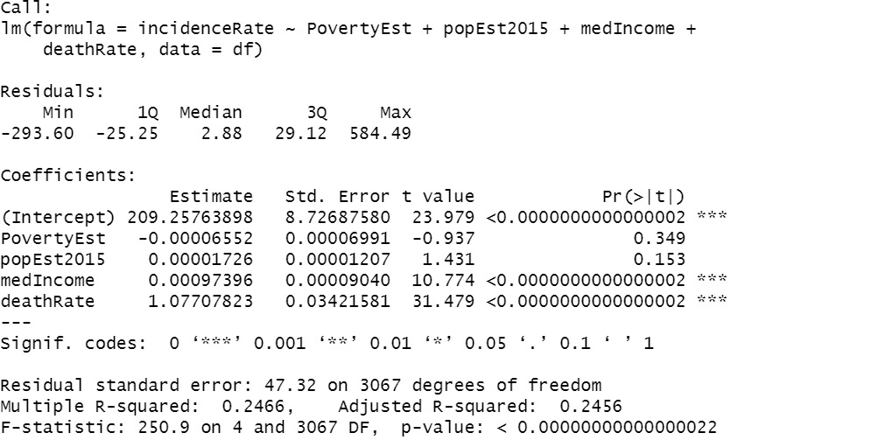
Regression model for the incidence rate

Slide 20
In the model summary, you can find the F-statistic and its associated p-value.
According to our example, the P-value of the F-statistic is 0.00000000000000022 which is highly
significant A significant relationship exists between at least one predictor variable and the outcome
Coefficients of determination or R square values show how much variation there is in the model. R squared in this situation is 0.2466. As a result, the model can explain approximately 24% of the data and 76% is unaccounted for. There is a low correlation between input variables and incidence rate, which indicates that there is no strong relationship between them. Moreover, the standard error is high, approximately 8.72687580, which indicates that the data are far from the regression line.
Slope coefficients help determine the relationship between input variables and target variables. Income and poverty estimate have negative coefficients, which indicates a negative relationship. Therefore, as these variables increase, the target variable (incidence rate) decreases. .
Similarly, as the Poverty Estimate increases by one, again with all else held constant, the incidence rate decreases by -0.00006552.

Slide 21
Death rate estimates with positive coefficients indicate that death rate and cancer incidence rate are positively correlated. As a result, if the death rate increases by one, the cancer incidence rate increases by approximately 1.07707823.

Slide 22
Thank you
“Cancer cannot cripple love, it cannot shatter hope, it cannot conquer the spirit.”

